Slide 1

Full Stack Development - MERN Stack
Introduction to FSD & IDE Setting
Presenting By:
G. Venkata Deepthi
(Full stack Mentor)

Slide 2
Agenda
Introduction to full stack development
Web application architecture
What is MERN?
Route Map of MERN stack Development
IDE and its Uses
Downloading of VS code
Set Up of Visual Studio Code
Introduction to HTML
History of HTML
HTML Documents
HTML Boilerplate

Slide 3



Introduction to full stack development
Process of developing both front end and back end is full stack development.
Back-end
Front-end
Data- base
Data-base

Slide 4
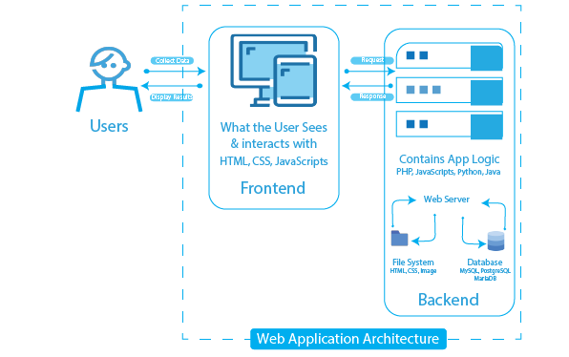
Web application architecture

Slide 5
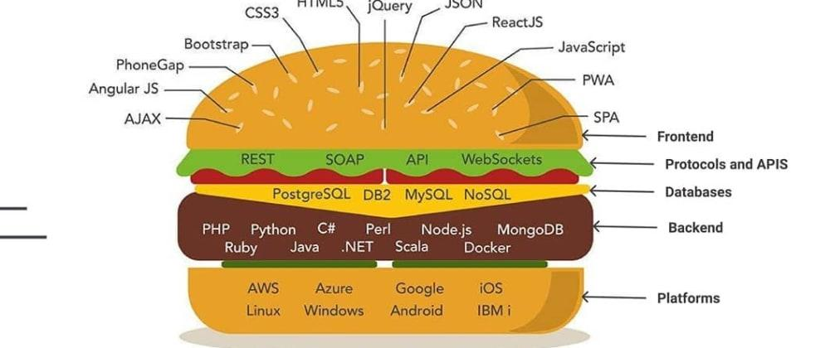

Slide 6
Web Development
Web Development
Front-End
HTML
CSS
Back-End
Node JS
Data-base
JavaScript
Express JS
Mongo-DB
MySQL

Slide 7
What is MERN?
MERN
Mongo-DB
Express JS
React
Node JS

Slide 8
Route Map of MERN Stack

Slide 9
Step-5
Step-6
Node JS , Express JS
Programming Server
SQL , Mongo DB
Data Manipulation
Step-4
Java Script
Interactive Elements
React
Step-3
HTML
Basic Text
and shape
CSS
Style HTML page,
Bootstrap
Step2
Step-1

Slide 10
IDE and its Uses
IDE → Integrated Development Environment
It is designed to provide facilities a programmer needs for software development
It provides text editor , debugger , compiler in one application.
Example → VS code, Eclipse, Net beans, Komodo etc…

Slide 11
Advantages of IDE
Look and feel Customization such as themes, fonts, color.
Auto compiles and runs code
Folder Structure for the project
Provide Syntax highlighting
Automatic indentation for code blocks
Line numbers
Auto code completion
Auto code for inherited members
Provide debugging functionality, identifying syntax and obvious errors
Often provide GUI builders(Drag drop systems) for increased speed
Plug ins for additional functionality + more

Slide 12
Downloading of VS code
Go to browser → type download VS code
Click on very first link https://code.visualstudio.com/download
Run the .exe file

Slide 13
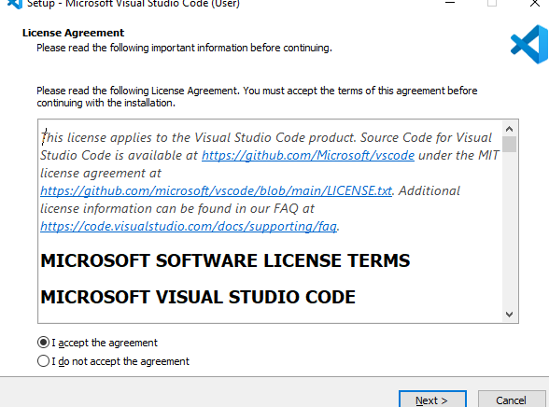
Downloading of VS code
Click next

Slide 14
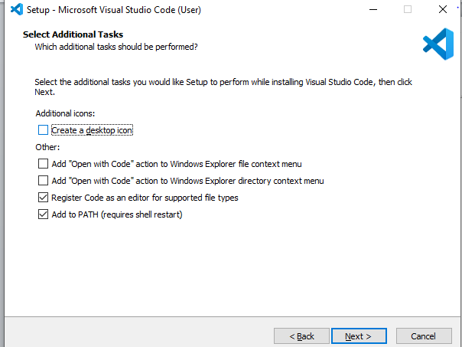
Downloading of VS code

Slide 15
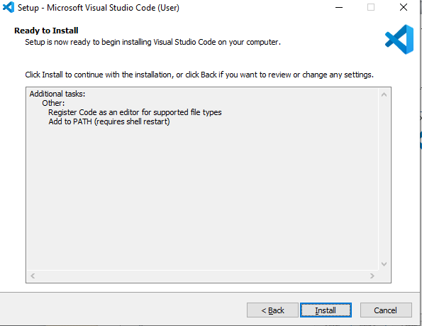
Downloading of VS code

Slide 16
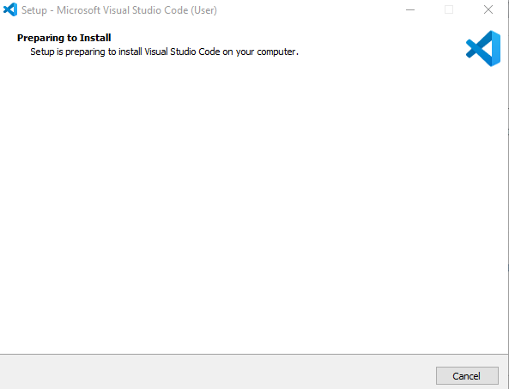
Downloading of VS code

Slide 17
Set up and Extensions of VS code
Extensions → Used to highlight text , auto complete, auto correct
Prettier
Live server
Auto rename tag
CSS peek

Slide 18
Introduction to HTML
HTML → hypertext markup language
Standard language used to create web pages
It is not case sensitive
It is forgiving language
Content and presentation
Semantic markup vs. Styling
Accessibility and flexibility

Slide 19
History of HTML
1989
Tim Berners lee invented www
1991
Invented HTML
1993
Dave raggett drafted HTML+
1995
HTML working group defined
1997
W3C Recommendation HTML 3.2
1999
HTML 4.01
2000
XHTML 1.0
2008
WHATWG HTML 5 first public draft
2012
WHATWG HTML 5 living Standard
2016
W3C Candidate recommendation of HTML5
2017
W3C Recommendation HTML 5.2
2014
W3C Recommendation HTML 5

Slide 20
HTML Documents
HTML 2.0
HTML 3.2
HTML 4.0
HTML 4.0 Frameset
HTML 4.0 Strict
HTML 4.01 Transitional
HTML 4.01 Frameset
HTML 4.01 Strict
<!DOCTYPE HTML PUBLIC "-//IETF//DTD HTML//EN">
<!DOCTYPE HTML PUBLIC "-//W3C//DTD HTML 3.2 Final//EN">
Transitional <!DOCTYPE HTML PUBLIC "-//W3C//DTD HTML 4.0 Transitional//EN""http://www.w3.org/TR/html4/loose.dtd">
<!DOCTYPE HTML PUBLIC "-//W3C//DTD HTML 4.0//EN""http://www.w3.org/TR/html4/strict.dtd">
<!DOCTYPE HTML PUBLIC "-//W3C//DTD HTML 4.01 Transitional//EN""http://www.w3.org/TR/html4/loose.dtd">
<!DOCTYPE HTML PUBLIC "-//W3C//DTD HTML 4.01 Frameset//EN""http://www.w3.org/TR/html4/frameset.dtd">
<!DOCTYPE HTML PUBLIC "-//W3C//DTD HTML 4.01//EN""http://www.w3.org/TR/html4/strict.dtd">
<!DOCTYPE HTML PUBLIC "-//W3C//DTD HTML 4.0 Frameset//EN""http://www.w3.org/TR/html4/frameset.dtd">

Slide 21
HTML Documents
HTML5
<!DOCTYPE html>
XHTML 1.0 Transitional
<!DOCTYPE html PUBLIC "-//W3C//DTD XHTML 1.0 Transitional//EN""http://www.w3.org/TR/xhtml1/DTD/xhtml1-transitional.dtd">
XHTML 1.0 Strict
<!DOCTYPE html PUBLIC "-//W3C//DTD XHTML 1.0 Strict//EN""http://www.w3.org/TR/xhtml1/DTD/xhtml1-strict.dtd">
XHTML 1.0 Frameset
DOCTYPE html PUBLIC "-//W3C//DTD XHTML 1.0 Frameset//EN""http://www.w3.org/TR/xhtml1/DTD/xhtml1-frameset.dtd">
XHTML 1.1
<!DOCTYPE html PUBLIC "-//W3C//DTD XHTML 1.1//EN""http://www.w3.org/TR/xhtml11/DTD/xhtml11.dtd">
XHTML 2.0
<!DOCTYPE html PUBLIC "-//W3C//DTD XHTML 2.0//EN""http://www.w3.org/MarkUp/DTD/xhtml2.dtd">
XHTML Basic 1.0
<!DOCTYPE html PUBLIC "-//W3C//DTD XHTML Basic 1.0//EN""http://www.w3.org/TR/xhtml-basic/xhtml-basic10.dtd">
XHTML Basic 1.1
<!DOCTYPE html PUBLIC "-//W3C//DTD XHTML Basic 1.1//EN""http://www.w3.org/TR/xhtml-basic/xhtml-basic11.dtd">

Slide 22
HTML Boilerplate

Slide 23
Questions?

Slide 24
Thank you

